Slide 1
Lambdas
Not to be confused with Lambada
Lambdas
Observers and lambdas
Visitors
Lambdas in Collection Library
Literature :
http://docs.oracle.com/javase/tutorial/java/javaOO/lambdaexpressions.html
http://it-ebooks.info/book/4428/ (Urma: relevant parts of chapter 1 – 5).

Slide 2

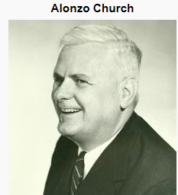
Lambdas
Lambdas are available in Java since version 1.8 (“Java 8”)
  Lambdas make functions “first class citizens”.
  Lambdas make it possible to work with higher order functions.
  A higher order function is a function (method) that accepts another function (lambda) as parameter.
  A lambda is an anonymous function witch can be passed to a method that accepts a functional interface as parameter. ← Java implementation
  Lambdas are sometimes called lambda expressions.
  The term “lambda” comes from the theory of functional programming. (Alonzo Church: Lambda Calculus, 1936).

Slide 3

Observers using lambdas
(amount) -> {
if(amount > 35)
System.out… :-)");
else
System.out… :-(");
}
If an observer wants a method called, when state changes, the method to call may be passed as a lambda to the observed object.
The observed object maintains a collection of lambdas.
When state changes all methods are called by notifyAll().
BottleState
addObserver( )
notifyAll( )

Slide 4
Observers using lambdas
java.util.function.Consumer<Integer>
is a predefined lambda with signature:
void foo(int)
import java.util.function.Consumer;
public class BottleState{
private int amount;
private Collection<Consumer<Integer>> observers;
public BottleState() {
this.amount= 0;
this.observers = new LinkedList<>();
}
public void addObserver(Consumer<Integer> obs) {
observers.add(obs);
}
public void notifyObservers() {
for(Consumer<Integer> observer : observers)
observer.accept(amount);
}
public void fillBottle(){
amount = 70;
notifyObservers();
}
Consumer<Integer> is used as type.
accept(int) executes the consumer method.
  ObserverDemos

Slide 5
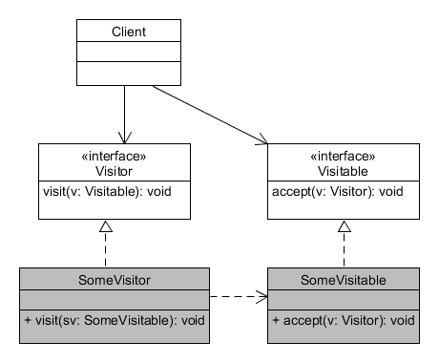
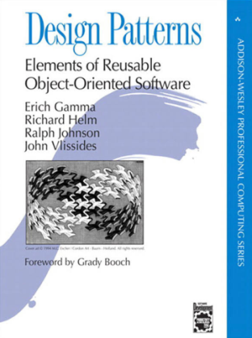
Visitor
Used for
traversing a collection
performing an operation
without knowing anything about the internal structure of the collection
May be simulated using the Visitor Pattern (GoF 1995)

Slide 6
Visitor Example with Lambdas
Traversing a collection and changing elements without knowing anything about the internal structure of the collection.
A sort of “mutator iterator”
visit():
(x) -> 2*x
(x) -> 2*x
Collection
changeAll( )
x
y
z

Slide 7
Visitor Example with Lambdas
Traversing a collection and changing elements without knowing anything about the internal structure of the collection.
A sort of “mutator iterator”
May be simulated using the Visitor Pattern (GoF 1995)
(x) -> 2*x
Collection
changeAll( )
x
y
z

Slide 8
Visitor – Higher order function
The library functional interface Function<in, out> can be used in the visitor method.
The Function interface defines a method apply. This method is called for every element in the container.
Call the visitor method on the container supplying a lambda expression (anonymous method) as argument. That method is substituted for the apply method in the interface.
public void modifyAll(Function<Integer, Integer> f){ //Applies f to all elements in the container
for (int i = 0; i < size(); i++)
a[i] = f.apply(a[i]);
}
//---
con1.modifyAll((x) -> 2*x);
//---
  VisitorDemo

Slide 9
Visitor – Higher order function
A functional interface is an interface that defines one method.
A functional interface may be used as parameter type in a method definition (a higher order function).
The actual parameters may be a lambdas with the same signatures as the corresponding methods defined in the interface.
public void modifySome(Function<Integer, Integer> f,
Predicate<Integer> p)
{//Applies f only to elements in the
//container that satisfis p
for (int i = 0; i < size(); i++)
{
if (p.test(a[i]))
a[i] = f.apply(a[i]);
}
}
//---
con1.ModifySome((x) -> 2 * x,
(x) -> x % 2 == 0);
//---

Slide 10
Lambda typing
How are lambda expressions typed? – by functional interfaces. Some examples…
(i) ->
{
...
}
Consumer<Integer>
() ->
{
...
return i;
}
Supplier<Integer>

Slide 11
Lambda typing
How are lambda expressions typed? – by functional interfaces. Some examples…
(i) ->
{
...
return d;
}
Function<Integer, Double>
(i) ->
{
...
return i==0;
}
Predicate<Integer>

Slide 12
Dissecting the lambda expression
Lambda operator
Function code (body) – could be a block in “{-}”
//---
con1.ModifySome((x) -> 2 * x,
(x) -> x % 2 == 0);
//---
Input parameter – could be a list of parameters
  VisitorDemo

Slide 13
Closures and lambdas
Sometimes you may want to use variables in the lambda expression that are not passed as parameters to the lambda:
The variable c is defined outside the lambdas scope.
The compiler computes the closure of the lambda.
The compiler generates a class with the lambda method and the needed variables, and it is actually this class that is passed around.
//---
int c = 2;
con1.modifySome((x) -> c * x,
(x) -> x % 2 == 0);
//---
  VistorDemo

Slide 14
Exercise
Add code to the lambda example, so all numbers greater than 20 in the container are increased by 7.
Add a new higher order function to the container:
public int sumSome(Predicate<Integer> p)
that sums the elements in the container that satisfies p.
Test by summing, for instance only elements greater than or equal to 20. Test with a predicate satisfied by all elements and with a predicate that is false for all elements.
Generalise your function, so it only sums elements in a given range (from start index to end index).

Slide 15
Lambdas in the libraries
The libraries have many higher order functions and lambdas are heavily used in the libraries.
Many library methods are to be called with a lambda expression as argument.
For instance in the Collection library there are higher order functions like:
    filter(Predicate<T> p) - returns elements satisfying p
    map(Function<T, R> f) - transforms elements from T to R
    foreach(Consumer<T> c) - applies c to all element
    anyMatch(Predicate<T> p) - returns true, if some element satisfy p
    reduce(Integer start, BinaryOperator<Integer> accumulator)
    - accumulates the value of the elements using the accumulator function
    and many more…
  LambdasInLibraries

Slide 16
Lambdas in the libraries
In order to use the higher order functions, one will need to get the elements in the collection as a Stream<T>
This is done calling the stream() method on the collection
Note, that most of the functions returns a new stream that can be used as input to the next function. They are called intermediate operations.
Functions that terminate the stream are called terminal operations,
//Counting evens using map-reduce:
int evenCount = numbers.stream()
.map((x) -> {
if(x % 2 == 0)
return 1;
else
return 0;})
.reduce(0, (a,b) -> a+b);
map returns a new stream with 1, if the element in the old stream is even, and 0 if not.
reduce sums the values in the new stream – that is, it counts.

Slide 17
Exercises – Session 12
Try some of the higher order functions defined on collections.
  For instance:
    Are all elements larger than 0.
    Find the sum of the odd elements.
    Find the square sum of the even elements.
Investigate this example:
PersonsAndLambdas
LambdasInLibraries

